Slide 1
CharRNN Text Generator: Exploring Language Modeling with PyTorch
Presented By:
Yuvan Velkumar S,
KGiSL Institute Of Technology,
NM ID:au711721243127

Slide 2

AGENDA
Problem Statement
Proposed Solution
Who are the end users?
Algorithm and Deployment
Results
Conclusion
References

Slide 3

PROBLEM STATEMENT
An AI-driven text generating system will be developed by utilizing a PyTorch-implemented character-level Recurrent Neural Network (RNN) architecture. To properly understand language patterns and structures, this system is trained using a corpus of text data. It then gains the ability to produce content that is logical and appropriate for the context from user input. The final objective is to enable the model to generate new text sequences with a high degree of similarity to the original training data in terms of both style and substance.

Slide 4

PROPOSED SOLUTION
The objective of this project is to develop a simple text generation model using a recurrent neural network (RNN) implemented in PyTorch. The model is trained on a small corpus of text data and then used to generate new text based on a given input prompt.
Project Components:
Data Preprocessing:The provided code preprocesses the input text data by tokenizing it into characters and converting them into numerical representations using one-hot encoding.
Model Architecture:the model architecture consists of a single-layer RNN followed by a fully connected layer.The RNN processes the input sequences and learns to predict the next character in the sequence.The fully connected layer maps the RNN output to the vocabulary size for character prediction.
Training:The model is trained using the provided training loop.It uses the Adam optimizer and CrossEntropyLoss as the loss function.The training loop runs for a specified number of epochs, updating the model parameters to minimize the loss.
Text Generation:Two functions, predict and sample, are provided for generating text.The predict function predicts the next character given a sequence of characters.The sample function generates a sequence of text starting from a given prompt using the predict function.
Usage:After training the model, the sample function can be used to generate text based on user-provided prompts.

Slide 5

WHO ARE THE END USERS?
Content Creators:Writers, bloggers, journalists, and other content creators might use the text generation model to generate ideas, brainstorm content, or overcome writer's block by providing prompts and letting the model generate potential storylines, article drafts, or creative passages.
Language Learners:Language learners could benefit from using the text generation model to generate example sentences or paragraphs based on specific grammar rules or vocabulary they are studying. The model could help them practice reading comprehension, grammar, and vocabulary acquisition in a contextualized manner.
Chatbot Developers:Developers of chatbots and virtual assistants might employ text generation models to enhance the conversational abilities of their bots. By integrating the model, chatbots can generate more human-like responses, engage users in longer conversations, and provide more personalized interactions.
Creative Writing Enthusiasts:Amateur writers, poets, and storytellers may find the text generation model useful for inspiration and exploration of new writing styles. They can use the model to generate starting points, plot twists, character descriptions, or dialogue snippets to kickstart their creative process.
Educational Institutions:Teachers and educators could utilize the text generation model as a teaching aid in language arts, creative writing, or computational linguistics courses. Students can interact with the model to learn about language structure, grammar rules, and creative expression.

Slide 6
ALGORITHM AND DEPLOYMENT
Data Preprocessing:Clean the text data by removing noise and tokenizing it into numerical representations.
Model Architecture:Choose an RNN architecture and define its parameters.
Initialization:Initialize the RNN model with random weights.
Training Loop:Iterate over the dataset for a specified number of epochs:Input sequences into the RNN model.Compute and minimize the loss using an optimization algorithm.
Evaluation:Periodically evaluate the model's performance using validation data.
Hyperparameter Tuning:Experiment with different hyperparameters to optimize performance.
Testing:Evaluate the final trained model on a test dataset to assess its performance.
Deployment:Deploy the trained model for inference in applications or services.

Slide 7
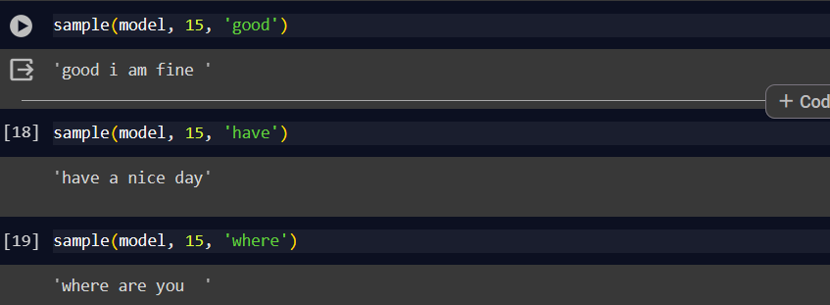
RESULTS

Slide 8
CONCLUSION
To sum up, developing a text generation model with recurrent neural networks (RNNs) offers a fascinating chance to produce comprehensible and contextually appropriate text in response to an input prompt. We've highlighted important phases from data preprocessing to deployment, with a focus on user-centricity, adaptability, and resilience. The capacity of the text generation model to produce interesting and captivating material that appeals to users—be they chatbot developers, language learners, or content creators—is ultimately what determines the model's success. Our goal is to develop a text generation model that gives exceptional outcomes and goes above and beyond expectations through continuous iteration and refinement.

Slide 9
REFERENCES
Cho, K., Van Merriënboer, B., Gulcehre, C., Bahdanau, D., Bougares, F., Schwenk, H., & Bengio, Y. (2014). Learning Phrase Representations using RNN Encoder-Decoder for Statistical Machine Translation. arXiv preprint arXiv:1406.1078.
Karpathy, A. (2015). The Unreasonable Effectiveness of Recurrent Neural Networks. Blog post. Available online: http://karpathy.github.io/2015/05/21/rnn-effectiveness/.
Graves, A. (2013). Generating Sequences with Recurrent Neural Networks. arXiv preprint arXiv:1308.0850.
Goodfellow, I., Bengio, Y., Courville, A., & Bengio, Y. (2016). Deep Learning. MIT Press.
Brownlee, J. (2019). Deep Learning for Natural Language Processing: Develop Deep Learning Models for Natural Language in Python. Machine Learning Mastery.
PyTorch Documentation: https://pytorch.org/docs/stable/index.html
TensorFlow Documentation: https://www.tensorflow.org/api_docs

